Slide 1
Deep EYE
Jayant Bangia
Savan Savaliya

Slide 2

ABOUT US
At Deep Eye, we’re building advanced software
that will catch the use of AI in student assignments and exams. We will use machine learning algorithms and data pattern recognition techs that no one has seen before.

Slide 3
PROBLEM
MARKET GAP
IMPACT
As AI technology such as Chat GPT and Gemini AI is getting more advanced existing technology is not that much polished or advanced to catch the use of it.
Due to the use of AI students are getting less creative and not thinking out of the box
CUSTOMERS
USABILITY
Every educational institution in the world.
The existing software are complex to use by aged teachers so keep the user interface easy to use.

Slide 4
SOLUTION
CLOSE THE GAP
One stop solution to find use of AI and paraphrased AI paragraphs from website like quill Bot
TARGET AUDIENCE
Educational Institution
COST SAVINGS
Subscription Models and special discount on the
EASY TO USE
A simple building design which any be used by every teacher

Slide 5
PRODUCT OVERVIEW
UNIQUE
TESTING
This software can catch everything from Google
paragraphs or paraphrased AI code. It will be
catch plagiarism in every language
This one of the most important part testing we are going to test are model on a million homework of various of school across the global
BOTH STYLE MODELS
AUTHENTIC
B2B – We can license the use of our software to big companies and institution
B2C- For small customer we will make an app and website where they subscribe to the model
This going to be our biggest selling point as we want to catch the 95% of the plagiarised content

Slide 6



PRODUCT BENEFITS
Easy to use for everyone
Carbon neutral
chip use
Can be used in multiple
languages

Slide 7
COMPANY OVERVIEW

Slide 8



BUSINESS MODEL
RESEARCH
DESIGN
ABSTRACT
Regular Research
Work required to keep up with AI use
We believe teacher
to given a great UI/UX
We can provide both Paas(Platform as a service) and Saas(Software as a sercvice)

Slide 9
MARKET OVERVIEW
$97.3B
$43.8B
$5B
EdTech market overview
globally
Market of anti-plagrism by 2030
Growing at CAGR(Compound Annual Growth Rate) 23%
yearly
In Revenue per year after 2025 year

Slide 10
MARKET COMPARISON
$10B
$500M
$10B
OPPORTUNITY TO BUILD
FREEDOM TO INVENT
THE BEST POLICE IN THE REGION
Min amount of business that can be reach by 2030
At least by the year of 2024
What to have the best algorithm
Software in the region

Slide 11
OUR COMPETITION
Deep Eye
COMPETITORS
Our product will have the highest accuracy rate in the world
Monthly subscription model
Special prices to huge vendors
Companies : Grammarly
Have fooled it
Companies :PlagScan
Have fooled it too
Companies : Copyscape and ProWritingAid
Have fooled it too too

Slide 12
OUR COMPETITION
CONVENIENT
DeepEye
Copy scape
EXPENSIVE
Grammarly
AFFORDABLE
PlagScan
INCONVENIENT

Slide 13
GROWTH STRATEGY
How we’ll scale in the future
JAN 2024
MAY 2024
OCT 2024
Roll out drafts to local companies in the region to help establish the product
Release the drafts to the general public and monitor performance of the software and regional market trends
Gather feedback from institution and educational institute

Slide 14
FIRST YEAR ACTION PLAN
Draft plans
Run focus groups
Gather feedback
Feb 2024
May 2024
Oct 2024
2024
JAN
FEB
MAR
APR
MAY
JUN
JUL
AUG
SEP
OCT
NOV
DEC
JAN
FEB
MAR
APR
MAY
JUN
JUL
AUG
SEP
OCT
NOV
DEC
Test with businesses
Regional launch
Deliver to client
Feb 2024
July 2024
Dec 2024

Slide 15
FINANCIALS
 | YEAR 1 | YEAR 2 | YEAR 3
Income
Users | 50,000 | 400,000 | 1,600,000
Sales | 500,000 | 4,000,000 | 16,000,000
Average price per sale | 75 | 80 | 90
Revenue @ 15% | 5,625,000 | 48,000,000 | 216,000,000
Gross profit | -2,000,000 | -5,000,000 | 10,000,000
Expenses
Sales & marketing | 5,062,500 | 38,400,000 | 151,200,000
Customer service | 1,687,500 | 9,600,000 | 21,600,000
Product development | 562,500 | 2,400,000 | 10,800,000
Research | 9,281,250 | 2,400,000 | 4,320,000
Total expenses | 7,593,750 | 52,800,000 | 187,920,000

Slide 16
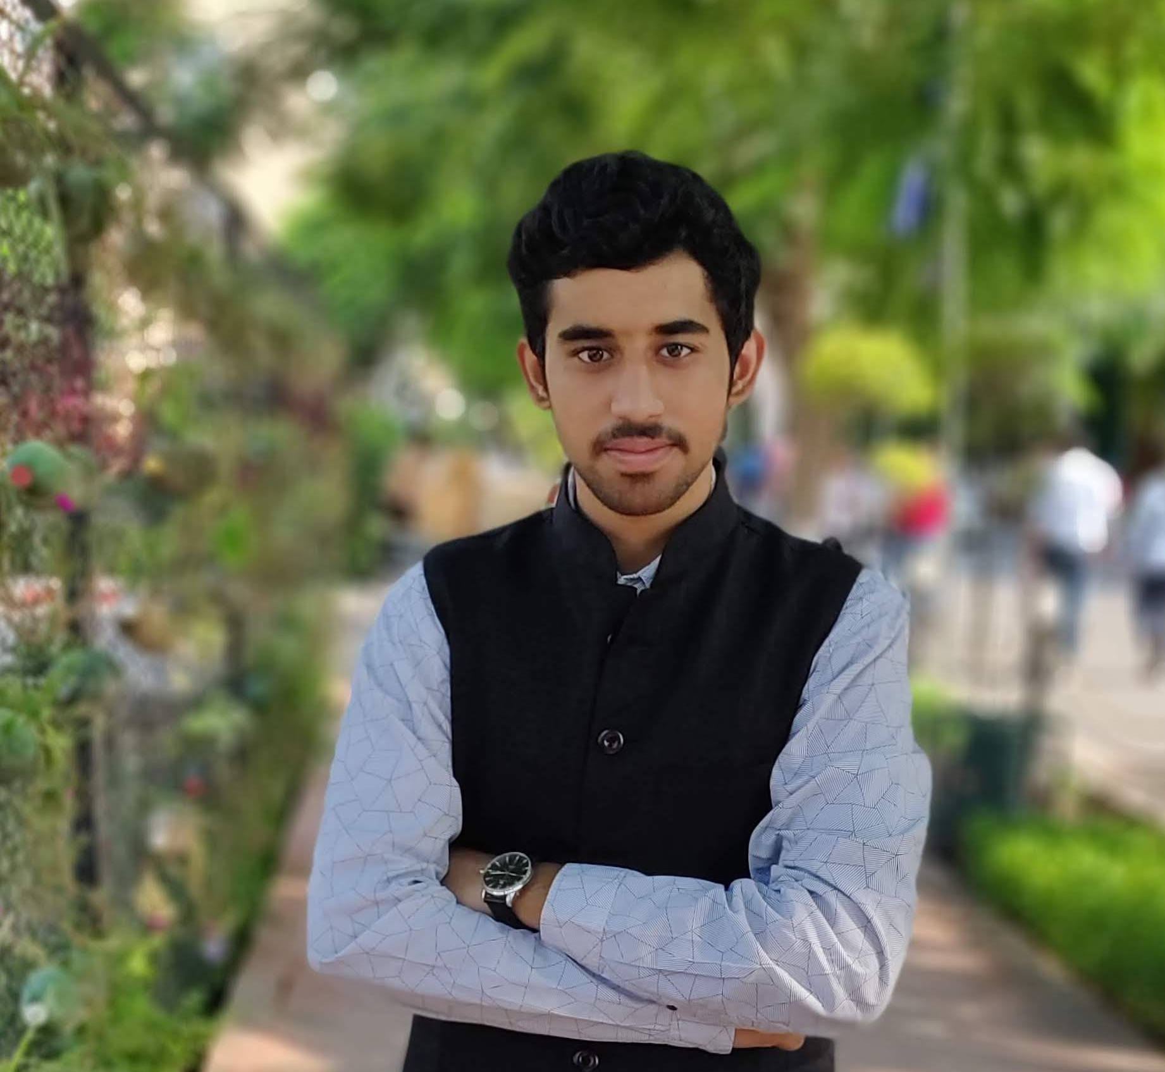
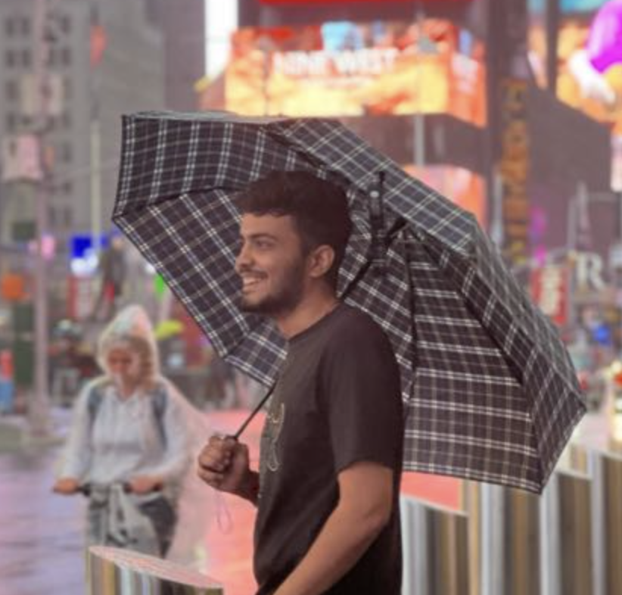
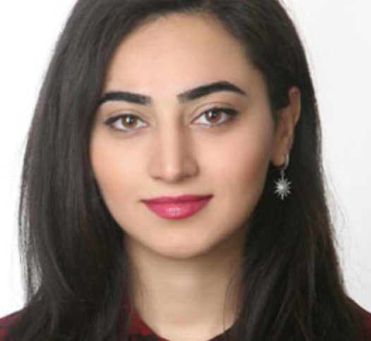
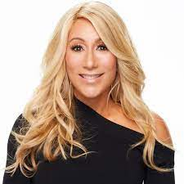
MEET THE TEAM
Jayant Bangia
Savan Savaliya
Samaneh Jafari
Lori Greiner
President
Chief Executive Officer
Chief Research Officer
VP Marketing

Slide 17
SUMMARY
In Deep Eye, our main aim is to bring students creatives out and help educational institutions check whether students are doing their assignments and exams with 100% effort as it is the most important thing in life.

Slide 18
THANK YOU

